Slide 1
Class of 2019
High School Choices

Slide 2
High School Choices
12 + 2 = 14
CCPS houses 12 Specialty Centers within its 10 high schools
There are 2 regional Governor’s Schools within the Richmond area

Slide 3
Clover Hill | Math/Science
Cosby | Health Sciences
James River | Leadership and international Relations
LC Bird | Engineering
Manchester | Mass Communications
Manchester | Spanish Immersion
Meadowbrook | Digital Entrepreneurship
Matoaca | Learning/Teaching Through Technology
Midlothian (and Meadowbrook) | International Baccalaureate
Monacan | Humanities
Monacan | Health and Physical Therapy
Thomas Dale | Visual and Performing Arts

Slide 4
Regional Governor’s Schools
Maggie L. Walker Government/International Studies Richmond | Appomattox Visual & Performing Arts/ Technology Petersburg

Slide 5
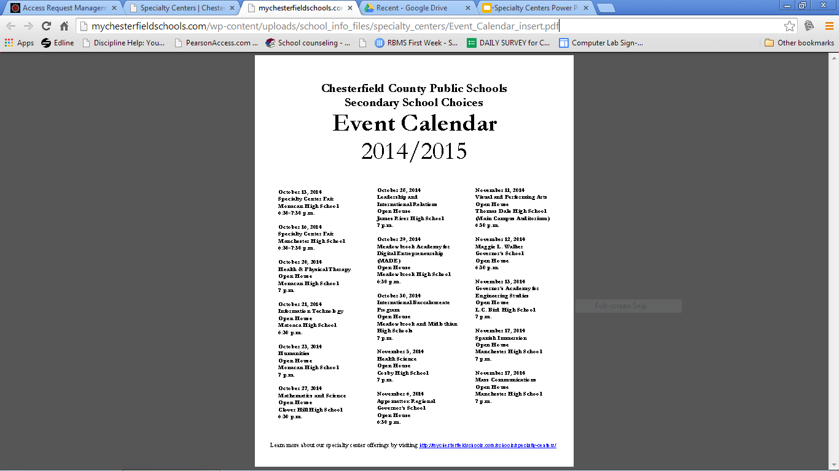

Slide 6
Step 1: Print out forms Online OR pick up forms in the School
Counseling Office*
A
P
P
L
I
C
A
T
I
O
N
*Governor’s School applications are ONLY available in the
School Counseling office
P
R
O
C
E
S
S
Step 2: Complete both pages of application (typed or in ink)
Step 3: Sign the recommendation form – Students and parents
Step 4: Ask two teachers to write recommendations
Each school requires certain teachers! Check before asking.
**If you give out a recommendation form, but then decide not to apply, you must let the teacher know.**
Step 5: Include your essay if required

Slide 7
Finding Applications Online:
You can access information two ways:
http://www.robiousms.mychesterfieldschools.com/ select Resources-School Counseling-Specialty Centers
OR go directly to:
http://mychesterfieldschools.com/schools/specialty-centers/

Slide 8
Application Deadlines
Maggie Walker
Appomattox Regional
~~~~~~~~~~~~~~~~~
Turn in to your counselor before 3: 00 on
Chesterfield County Specialty Centers
~~~~~~~~~~~~~~~~
Turn in to your counselor before 3:00 on
December 1, 2014
December 1, 2014
Please mark your calendars now
** No late applications will be accepted **

Slide 9
Teacher Recommendations -
4 things you have to get right
You must ask your teacher by November 21
Each school requires two recommendations
Ask the RIGHT teachers - check before asking
Provide teacher with the correct form filled out correctly

Slide 10
Frequently Asked Questions
Who can apply?
All 8th Graders
Space is limited - have your application and teacher recommendations in order
When will applications be available?
County Specialty Centers:
Available Now Online
Governor’s Schools:
Wednesday, October 15, 2014 School Counseling Office

Slide 11
Frequently Asked Questions
Can I apply to more than one specialty center?
Yes - but be reasonable.
When will I know if I have been accepted?
Letters are sent home in early March.
How will I get to the school if I am accepted?
Buses pick up at specific places - likely your home school.

Slide 12
Suggestions for Success
Listen to announcements
Be aware of all requirements & due dates
Turn in materials on time
Make sure applications are neat, complete, and easy to read
Include all necessary signatures (Both parent and student)
Incomplete applications will not be accepted

Slide 13
Questions???????
Please feel free to reach out to your school counselor with any additional questions

